Slide 1
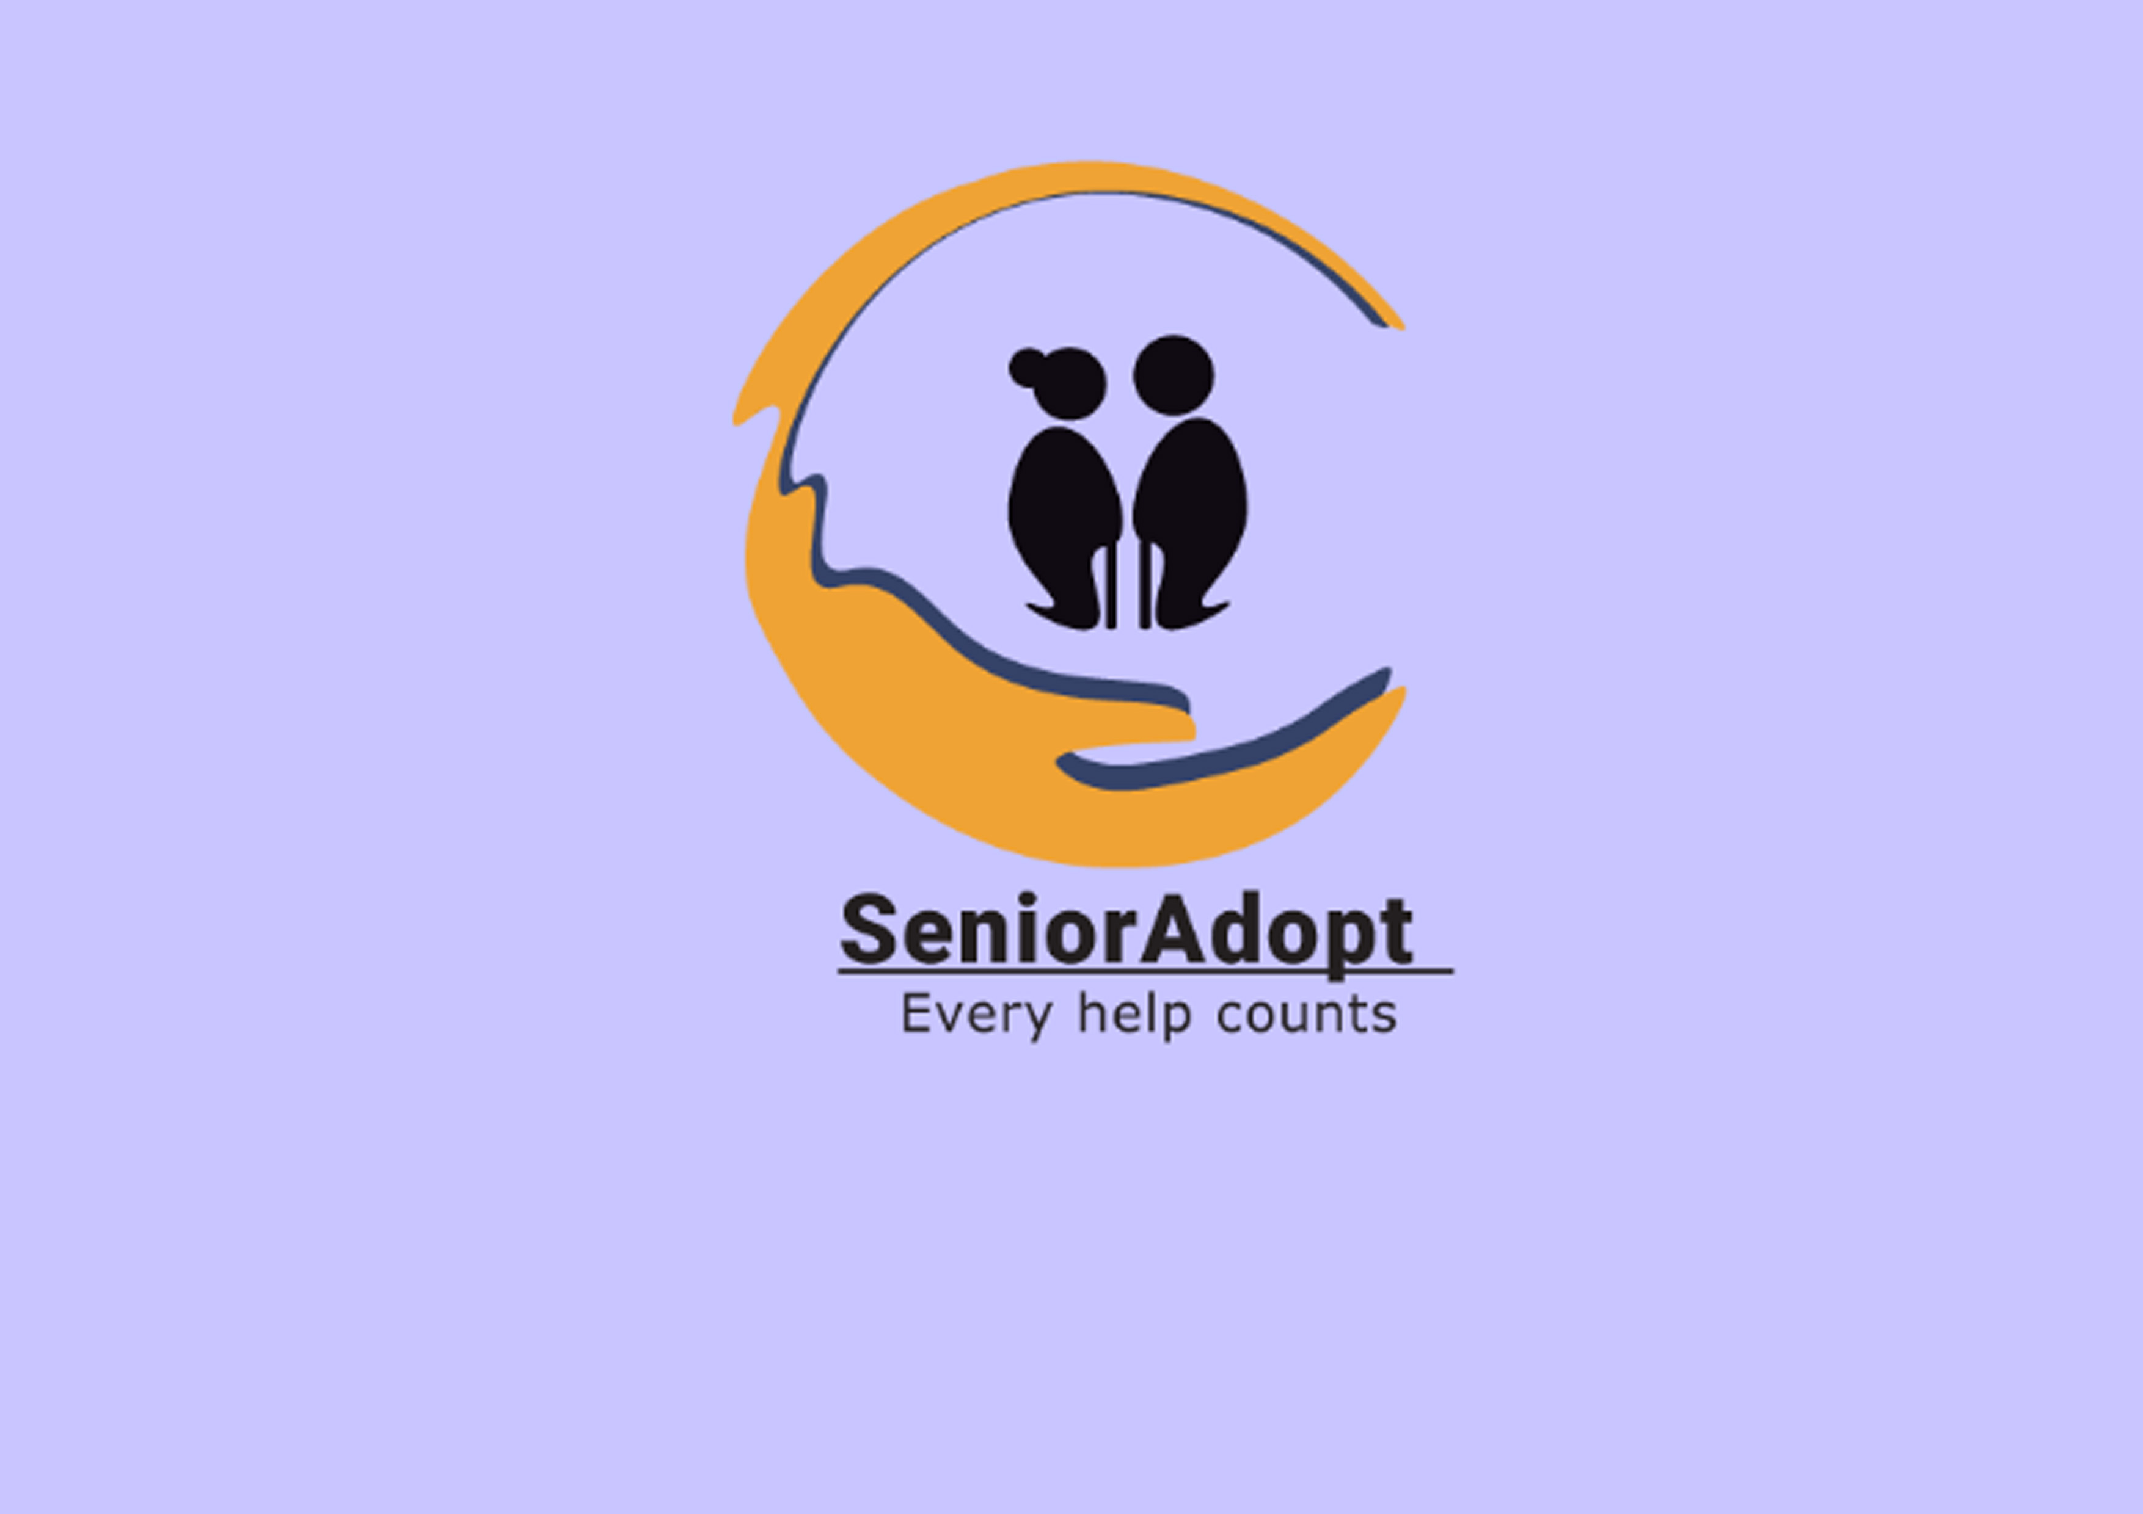

SeniorAdopt
Group 10:
Roxana Ciucioiu
Miriam Corvinus
Haizea Garaño Jauregui
Trina Koomtrakool
Eric Michael Lea Paulsen
Jonathan Pham
Johan B. Reitan
Høgskolen i Østfold / Østfold University College
Autumn 2021
Notes:
Terrible resolution on the cover pic, I know!

Slide 2


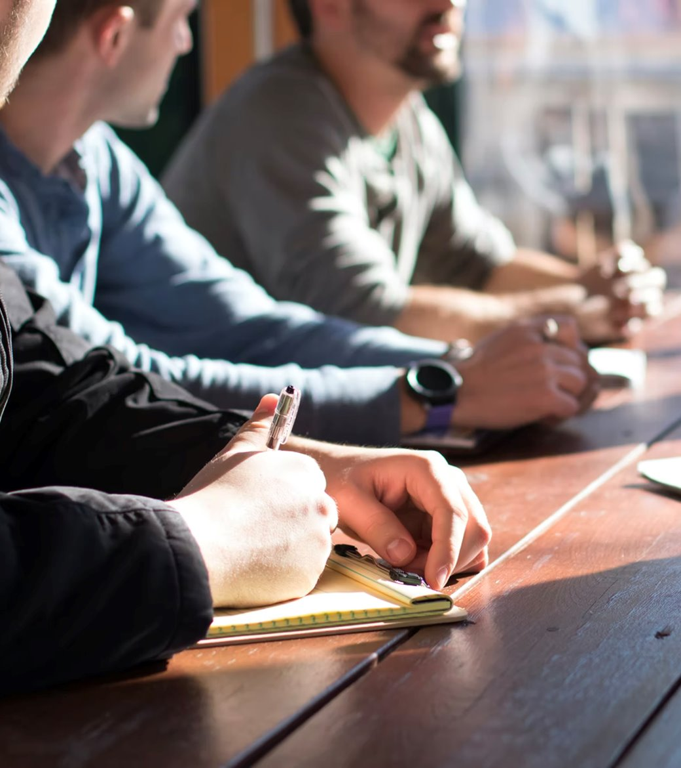

Our company
Based in Norway
Develop an app for seniors and juniors
Connect the old generations with the young ones through several kinds of services
Solve the non-assistance to elderly issues
Reduce the lack of technology knowledge among seniors
unsplash.com

Slide 3
Our team
Jonathan, CEO
Eric,
Vice President
Miriam,
Sales Manager
Johan,
IT Manager
Haizea,
Product Manager
Roxana,
HR Manager
Trina,
App Designer

Slide 4
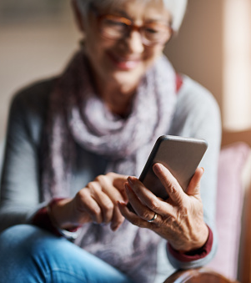
Our vision
Connects seniors with reliable and available teenagers or students
Offer professional experience to teenagers and students
Sharing skills and knowledge with elderly
Values: Trust, Caring, Sharing
unsplash.com
Notes:
The point is that the investors get a clear idea what SeniorAdopt's main idea is.

Slide 5
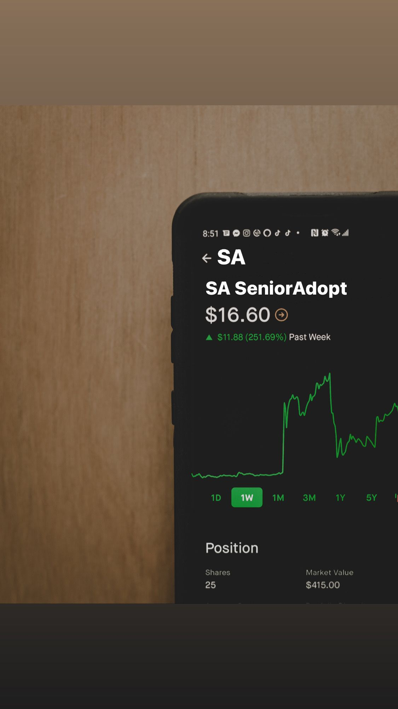
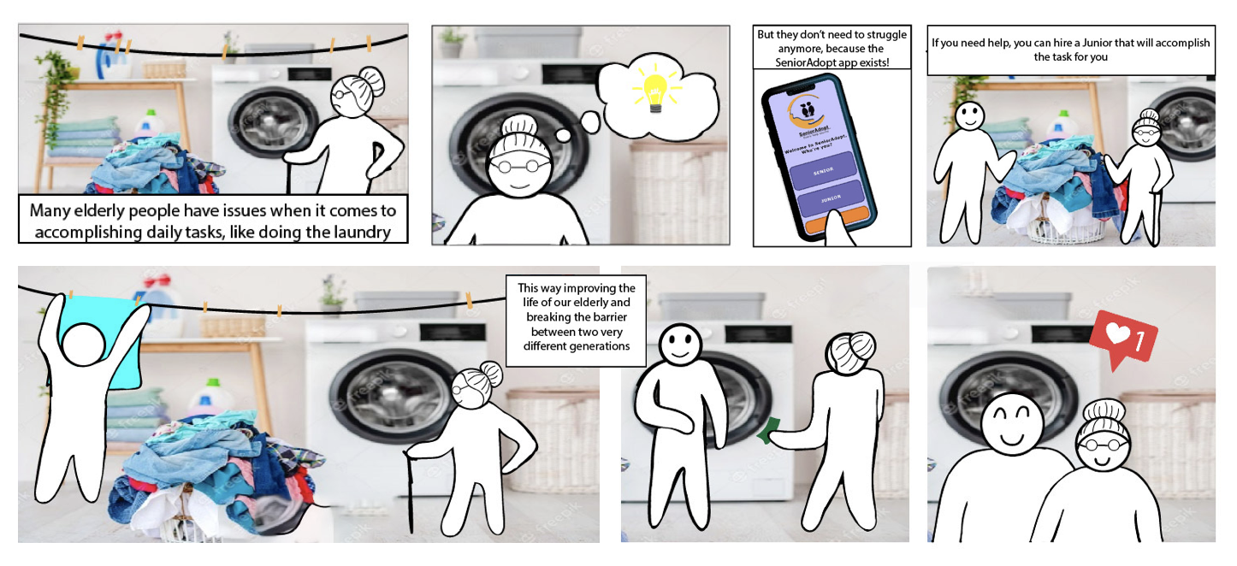
Market
The senior
Past the age of 60
The junior
Between the ages of 16 and 23
unsplash.com
Notes:
The senior (primary userbase), past the age of 60
The junior, between 16 and 23
Ways to help this two groups:
-Helping young people to find a job that suits them.
-Help both groups to earn more of connection towards the age groups.
-Adasdasdasdasd last one

Slide 6
Competitive landscape
SeniorAdopt's main competitors offering similar services:
 | Nabohjelp | WeCare | SeniorSmart | SeniorAdopt
User friendly | ✓ |  |  | ✓
Privacy | ✓ | ✓ | ✓ | ✓
Quality | ✓ |  |  | ✓
Norwegian | ✓ | ✓ | ✓ | ✓

Slide 7
Business model
SOCIAL JOBS
No fees.
MANUAL JOBS
Small fee per hour.
Commission at 25%
PRACTICAL JOBS
Larger fee per hour.
Commission at 25%
Notes:
Fee/hour for each assistance
Prices: Manual: 180NOK – 210NOK
Practical: 220NOK - 250NOK
Commission: 25%

Slide 8
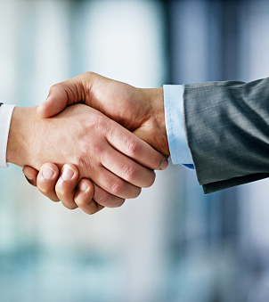
Partnerships
Sport activities centres
Spa centres
Cinemas and theatres
unsplash.com

Slide 9
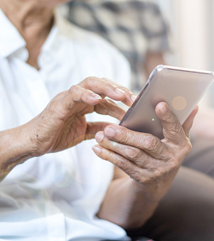
Product
Minimalistic design
Simple functionalities
Intuitive user experience
Available on all smartphones
Free downloading
unsplash.com

Slide 10
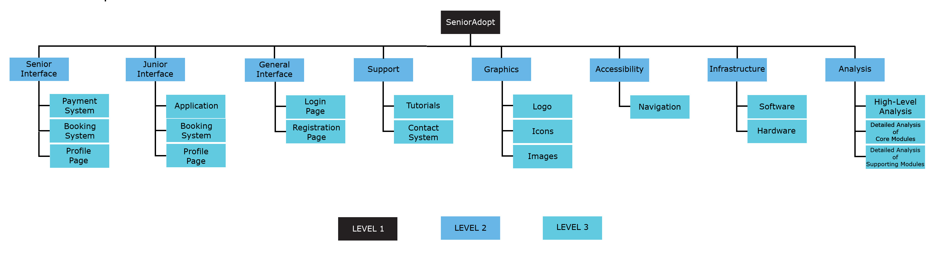
WBS

Slide 11
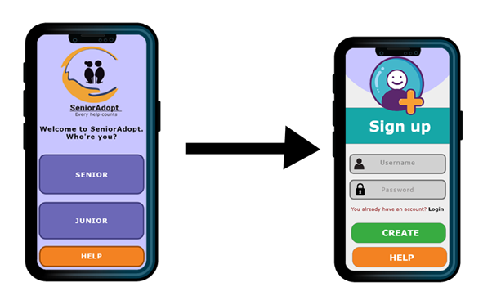
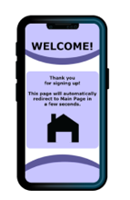
The SeniorAdopt app interface for a first-time user
Notes:
Fig#1: App Front page
Fig#1.2: Sign-up page
Fig#1.3: Welcoming Page

Slide 12
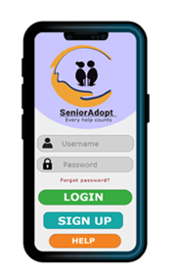
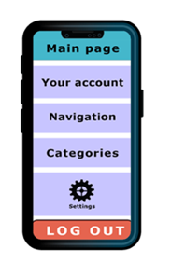
The SeniorAdopt app interface for a senior first-time user
Notes:
Fig#2: Start Page
Fig#2.1: Main Page

Slide 13
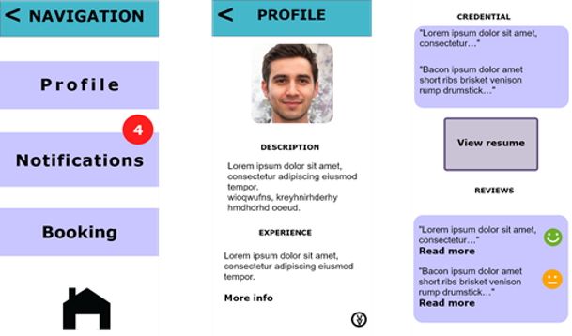
Navigation and Profile

Slide 14
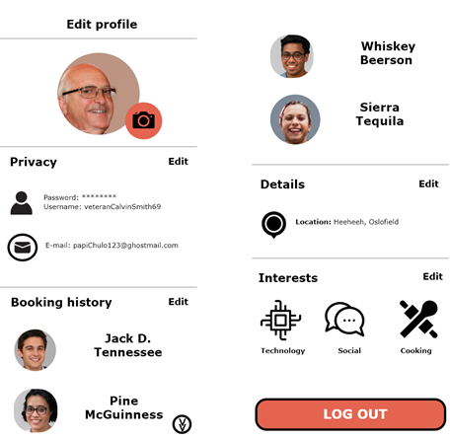
Senior Interface: Your Account

Slide 15
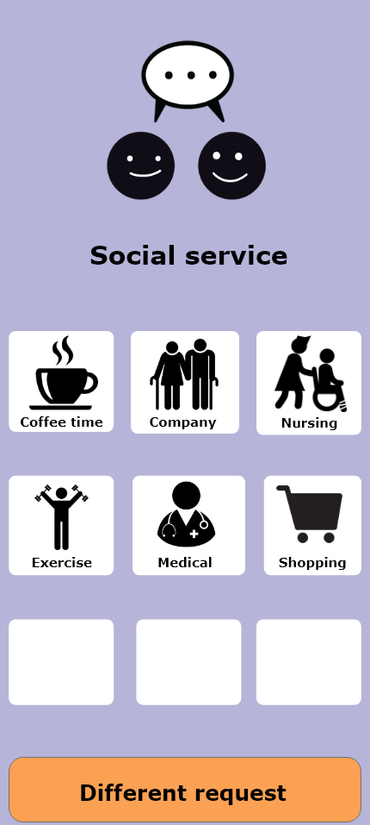
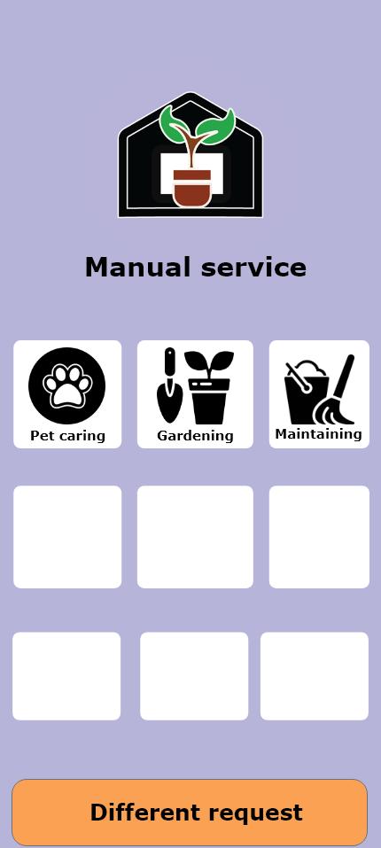
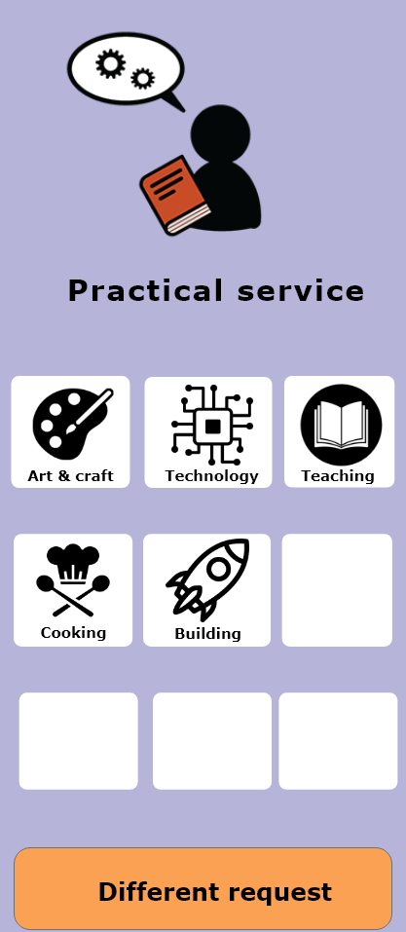
Categories

Slide 16
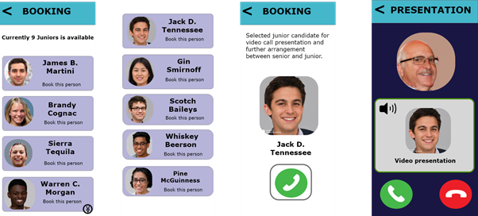
Booking and Video Presentation

Slide 17
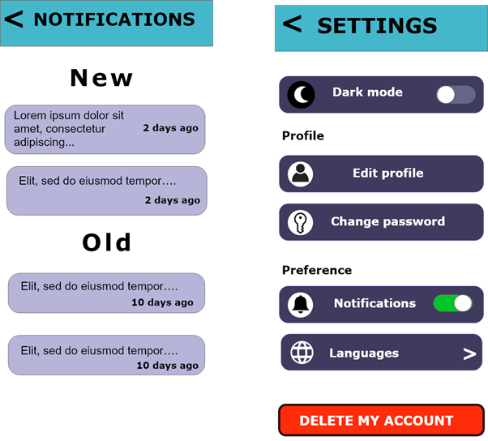
Notifications and Settings

Slide 18
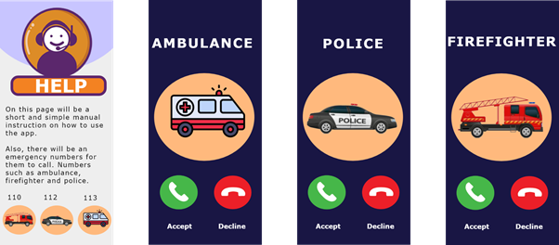

Slide 19
Budget

Slide 21
Notes:
Total of 6 358 673

Slide 22
Revenue
All purchases we take a 25% cut after VAT
Month 1
Month 2
Month 3
Month 4
Month 5
Year 1
Year 2
Year 3
Year 4
Year 5
Notes:
2 month: 9600 hours, 180 nok

Slide 23
Funding requirements and payback
Notes:
Funding 6 mil
Investor get 70% netprofit
Profit 4.8 mil
Sell app 5 years
30% would go to the investor 9.3 mil
Total: 14 mil
7.8 mil ROI
ROI = Return on investment

Slide 24
Risks Management
Determine the risks by approaching earlier documents
Assess their impact according to:
TIME
COST
QUALITY
Analyze, rank, prioritize
Review and mitigate

Slide 25
Before mitigation:
Data gets destroyed, disappear, or get corrupted. | Private data and company files might be stolen or lost. This will cost a lot of TIME, MONEY and QUALITY. | 5 | 3 | 15 | Have a good backup system with multiple backups, use of git, and backup regularly. | IT Operations Manager
After mitigation:
Data gets destroyed, disappear, or get corrupted. | The files are quickly recovered from a backup, if possible, now it will cost little time, and maybe a small amount of money. | 2 | 2 | 4

Slide 26
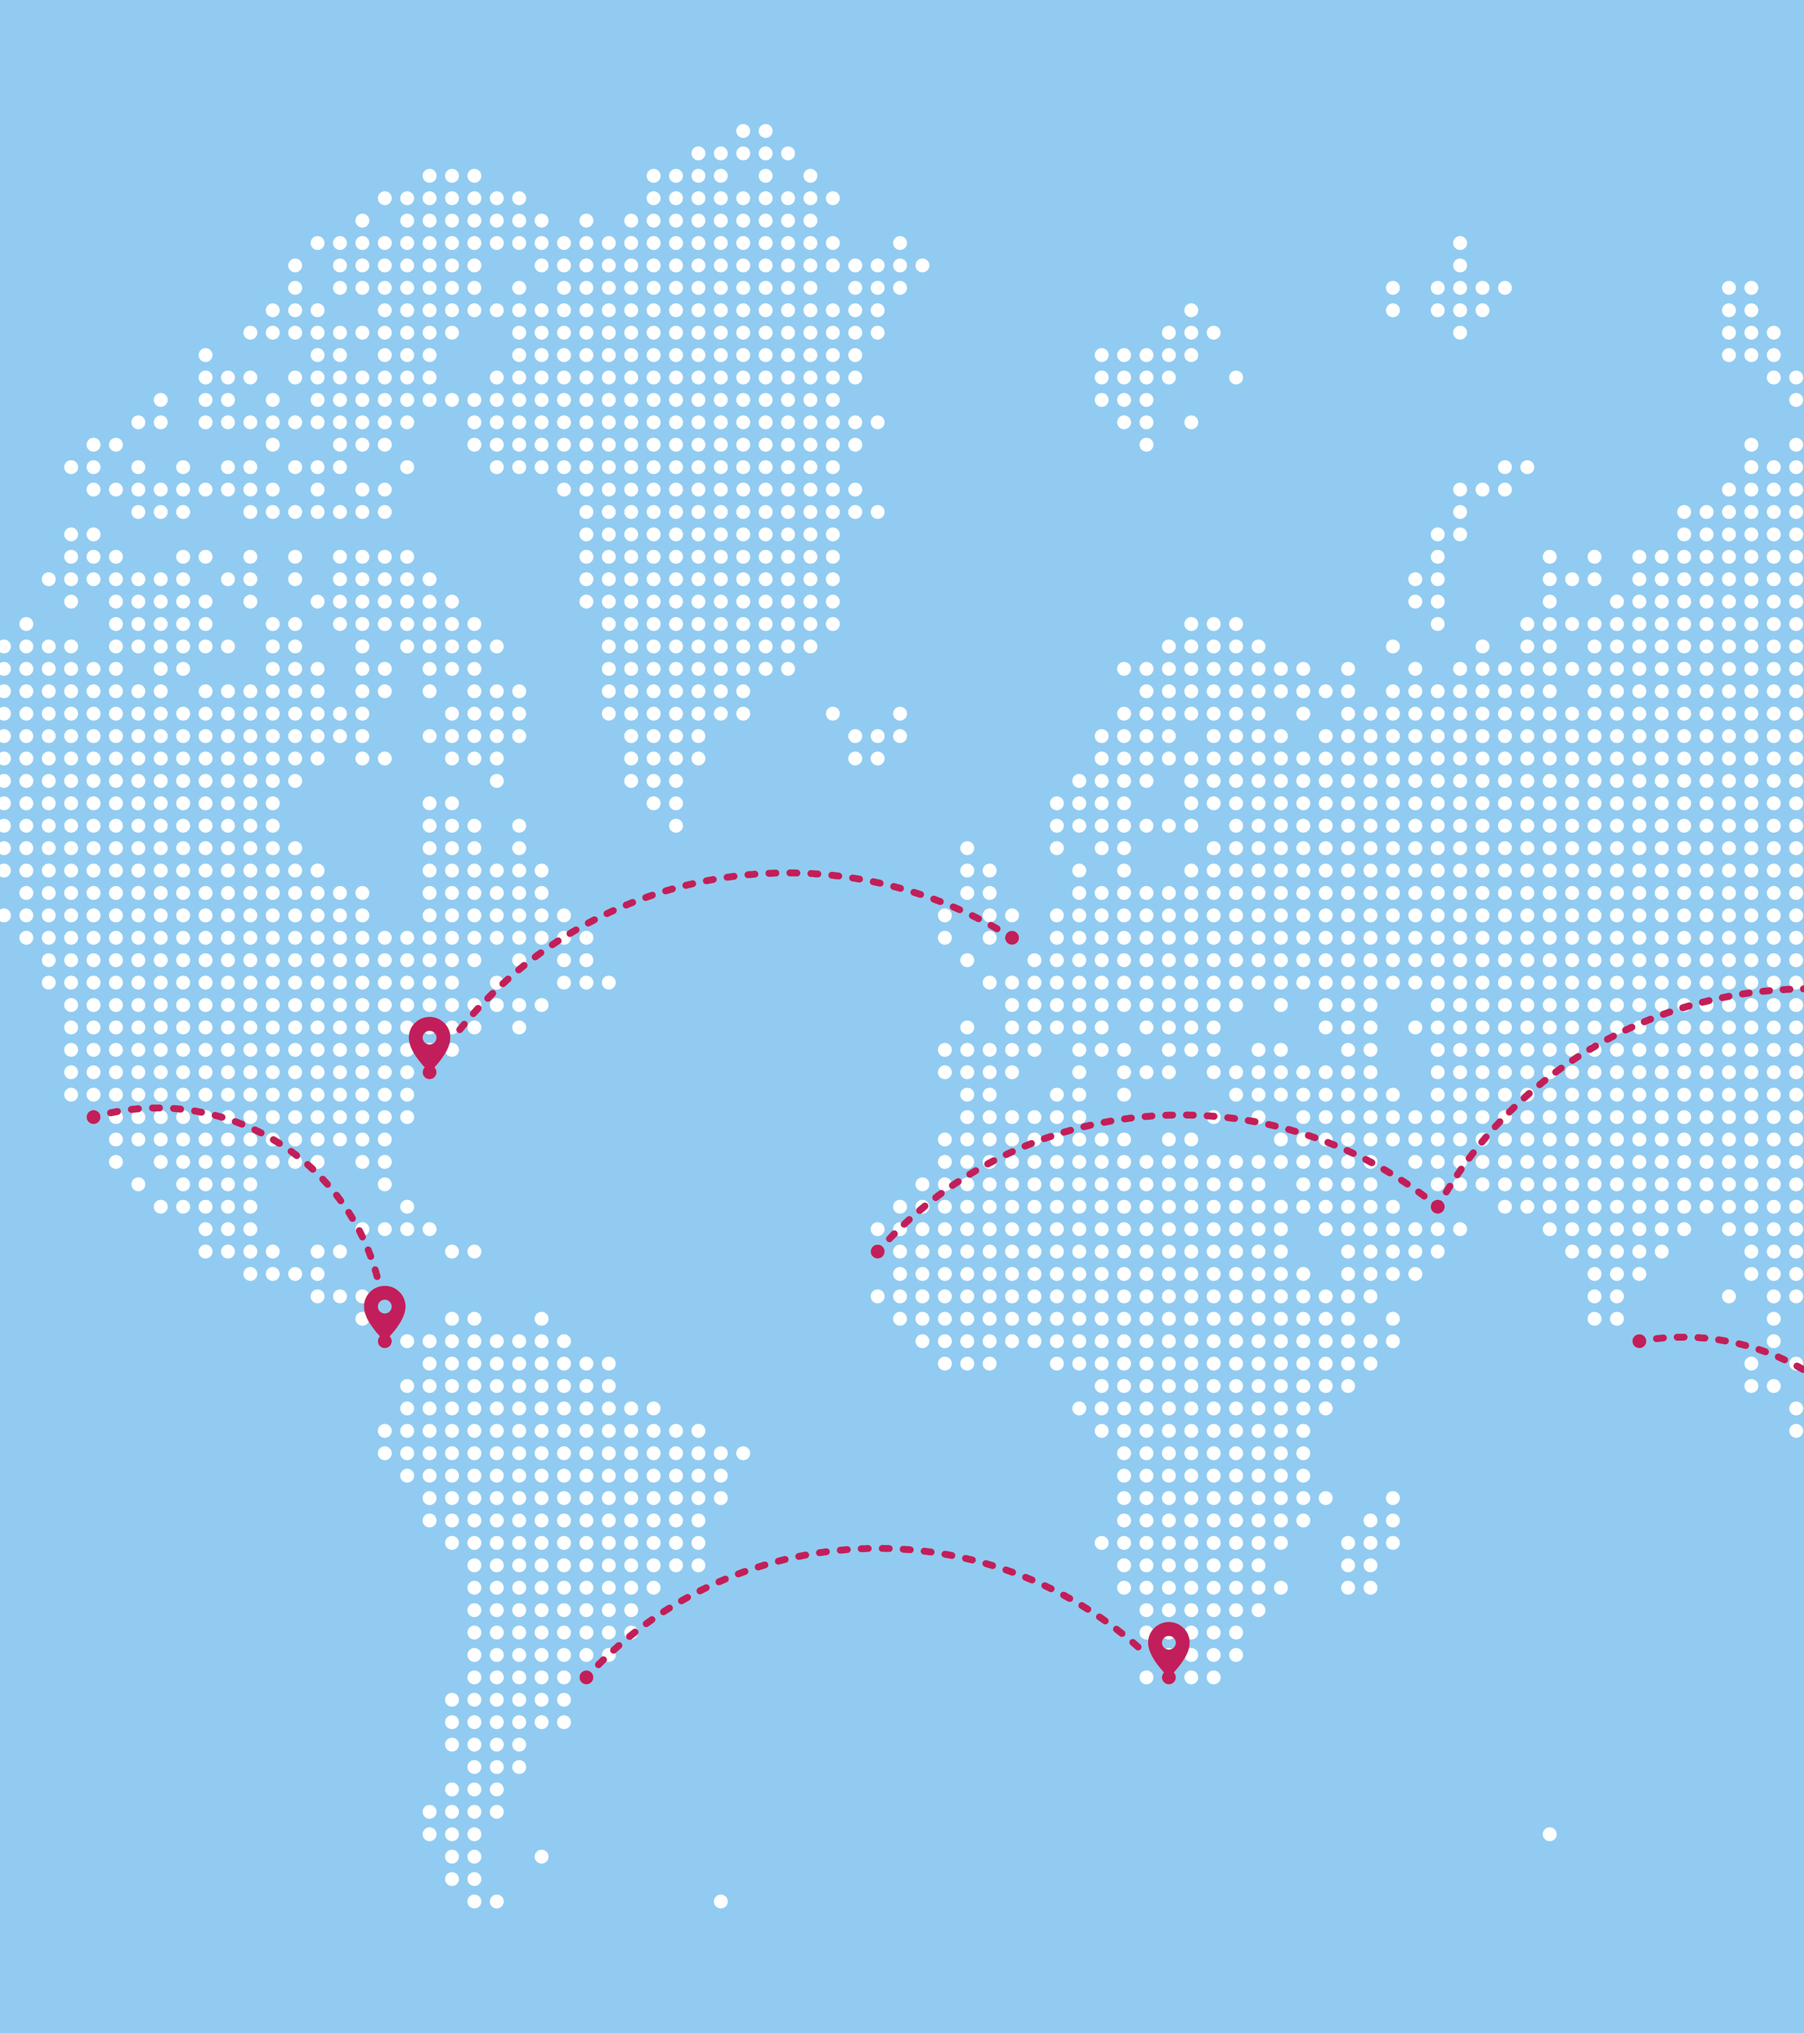

Contingency
Expand the market
Always changing
“Social” distancing
Source: https://logos-world.net/meta-logo/
Powerpoint Stockphotos
Powerpoint Stockphotos

Slide 27
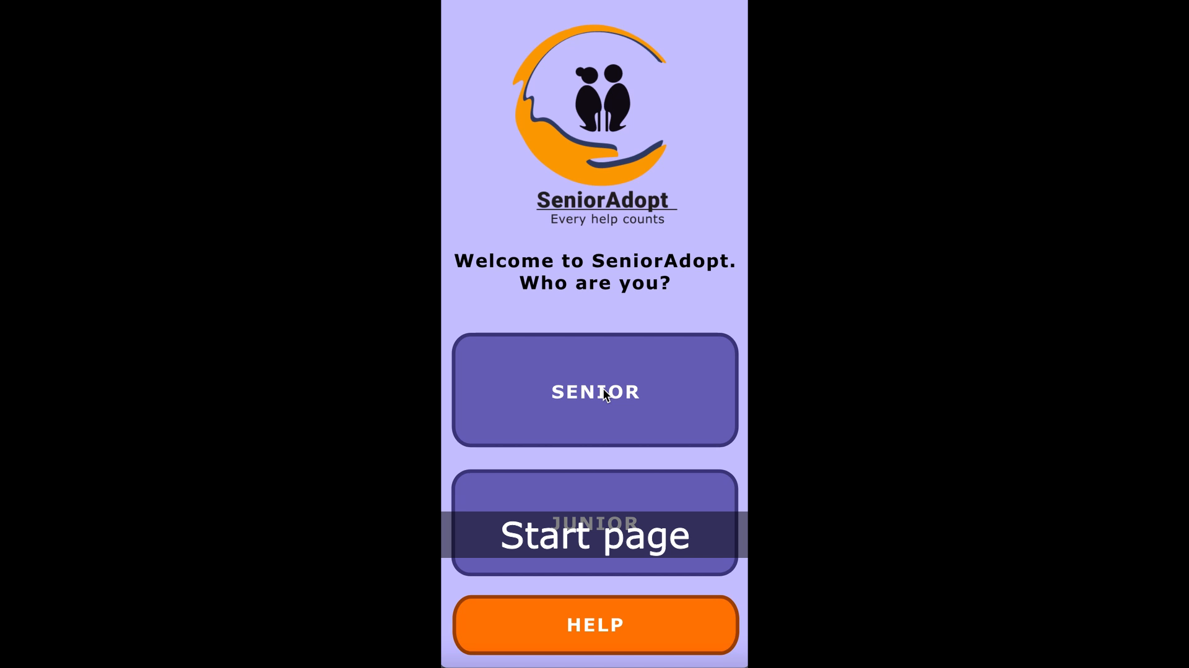
Product demo

